Slide 1
Implementation Team
Nick Mcmahon
Eric blumenstock
Tianran Hao
Josh Houston

Slide 2
How did we Implement?
Language?
C# Application Windows Form
Methodology?
Rapid Prototyping
How we split up the work?
Nick – Dimensional change calculation
Chris – Density calculation
Eric – Beam deflection calculation
Josh – database, displaying categories, species, and species description

Slide 3
How did we store the information?
Database?
User did not want to pay for high priced services
Hard for users to maintain
Text file?
Unorganized
Where to store at

Slide 4
SQLite
What is it?
SQLite is a software library that implements a self-contained, serverless, zero-configuration, transactional SQL database engine.
How does it work?
Download from there site, run the sqlite application, which is command-line based, create a database file, and begin creating tables and adding data.
How does it integrate?
With a C# application like we developed, you can download the SQLite package within Visual Studio and reference to the project which will allow, opening connection, closing connections, and reading data from your created database.
SQLite

Slide 5
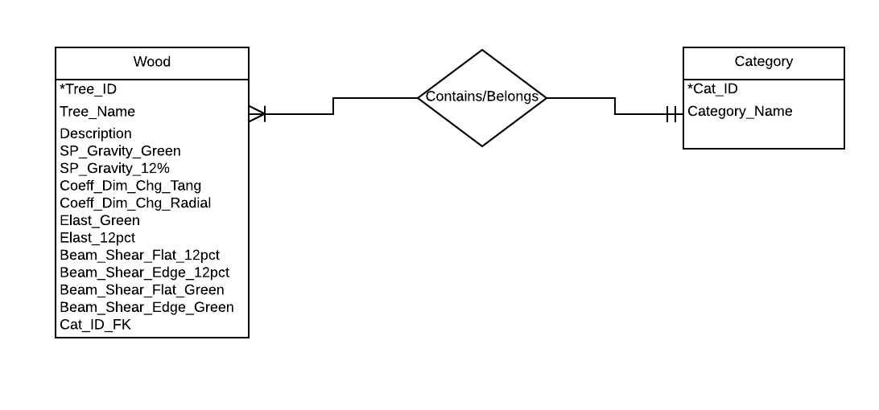
ERD Diagram

Slide 6
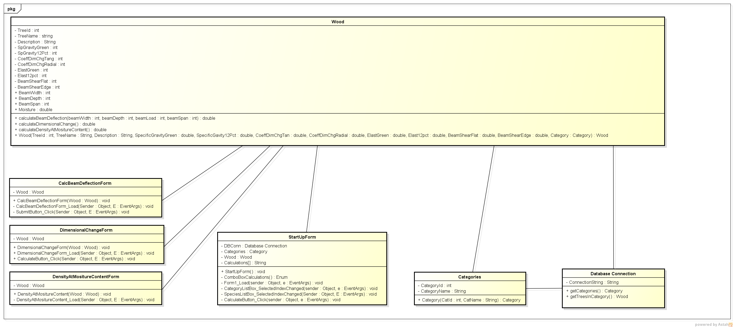
UML Diagram

Slide 7
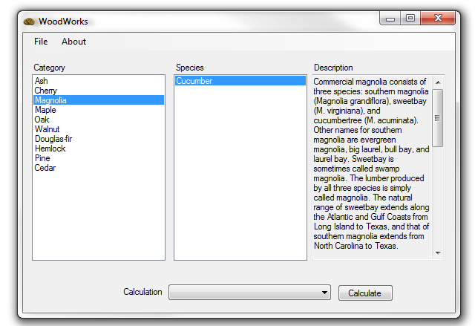

Slide 8
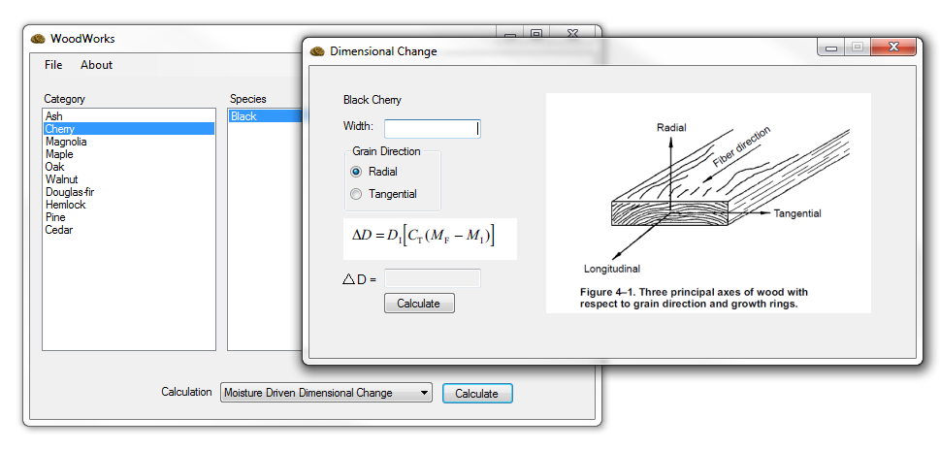
Dimensional Change

Slide 9
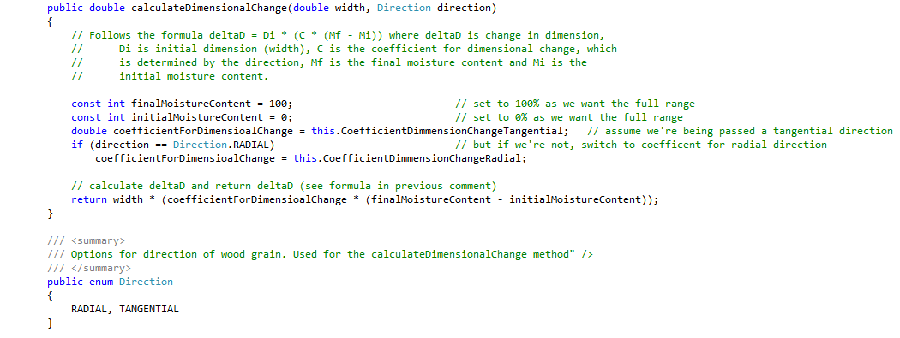
Dimensional Change (cont.)

Slide 10
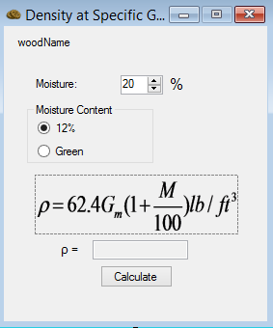
Density

Slide 11
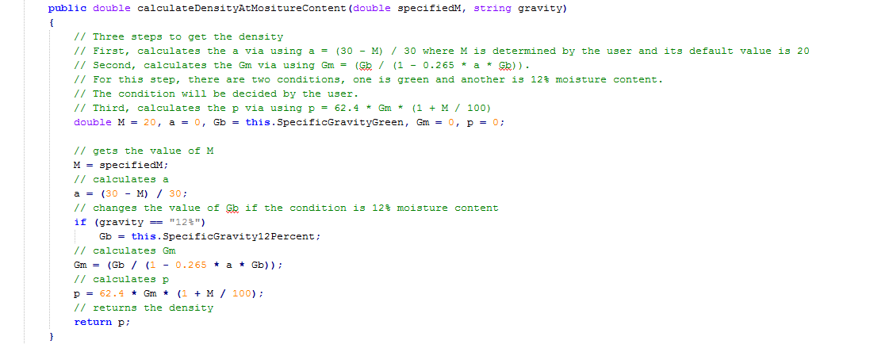
Density (cont.)

Slide 12
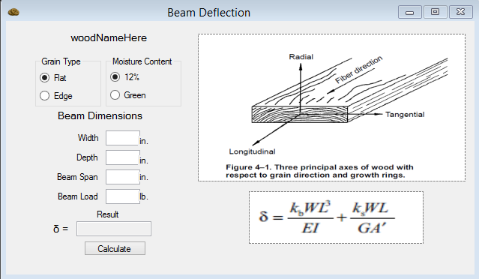
Beam Deflection

Slide 13
Beam Deflection (cont.)
//KB and KS constants
const double KB = 0.020833333333; // 1/48
const double KS = 0.25; // 1/4
//Calculate beam moment of inertia
// I = (b * h^3) / 12
double inertia = (beamWidth * Math.Pow(beamDepth,3) / 12);
//Calculate the modified beam area
// A` = 5/6 * b * h
double area = (5.0 / 6.0) * beamWidth * beamDepth;

Slide 14
Beam Deflection (cont.)
//Calculate beam deflection
// beamDeflection = ((( KB * W * L^3 ) / (E * I )) + (( KS * W * L) / ( G * A` )))
return (((KB * beamLoad * Math.Pow(beamSpan, 3)) / (elasticity * inertia)) +
((KS * beamLoad * beamSpan) / (beamShear * area)));

Slide 15
Beam Deflection (cont.)
MessageBox.Show("All entries must be positive numbers.", "Error", MessageBoxButtons.OK, MessageBoxIcon.Error);
resultDisplay.Text = String.Empty;
MessageBox.Show("Wood type " + wood.TreeName + " has no beam shear for specified grain type and moisture content.", "Error", MessageBoxButtons.OK, MessageBoxIcon.Error);
resultDisplay.Text = String.Empty;

